Slide 1
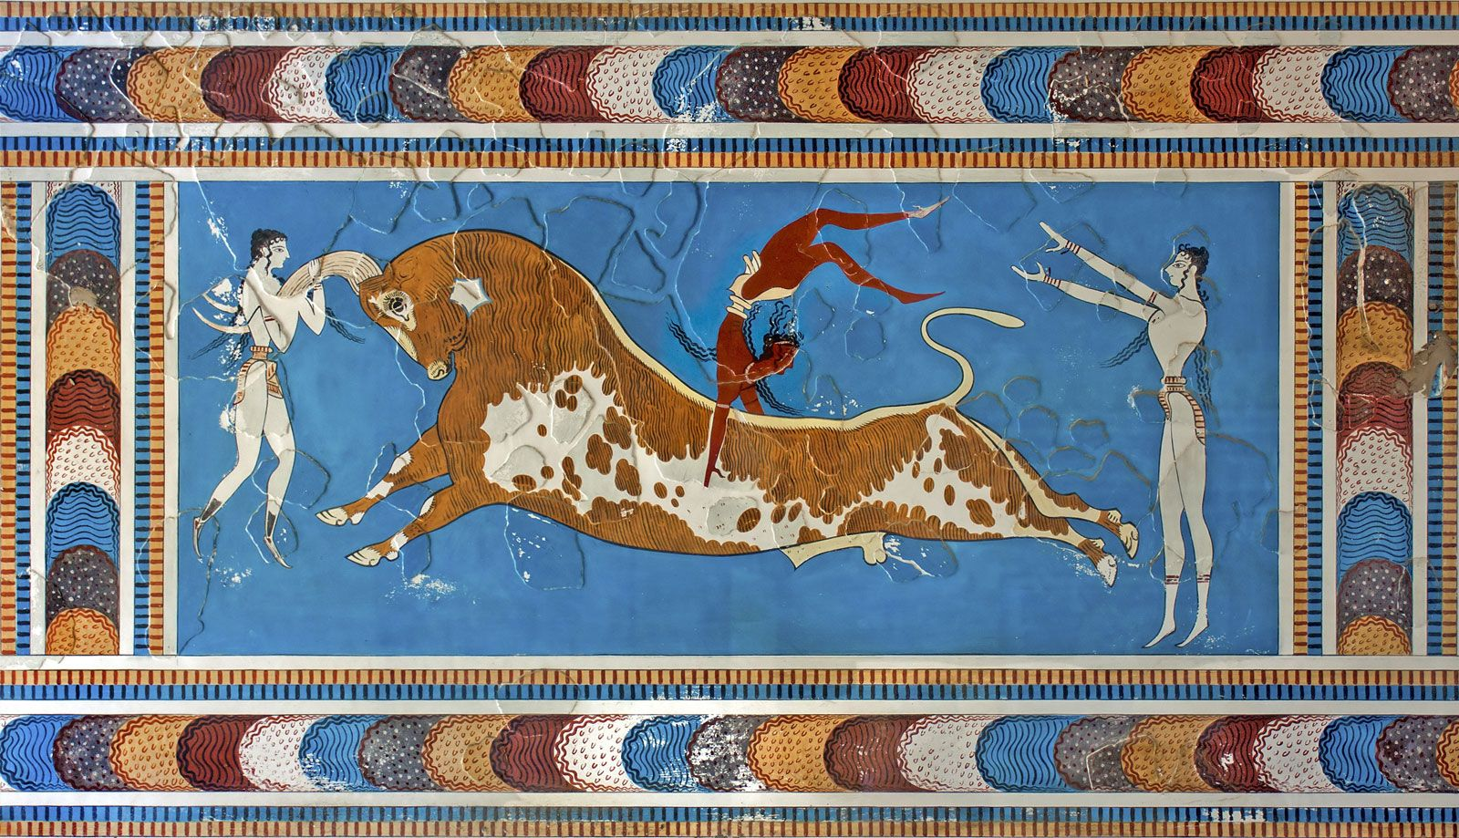
Minoans – Social Structure
Goal/s:
Identify and describe the key features of the Minoan social structures
Week 3 Lesson 1
Ms Barrie

Slide 2
Activity 1 – Portfolio Task Feedback
Read through Feedback on Portfolio Task
Answer the following question: what could I do to improve next time?
Put Portfolio Task in assessment folder

Slide 3
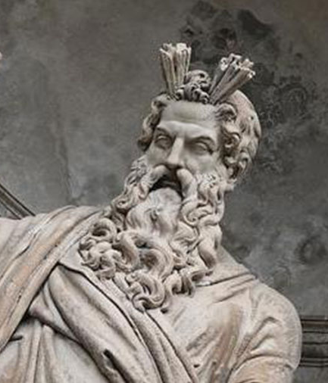
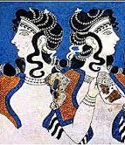
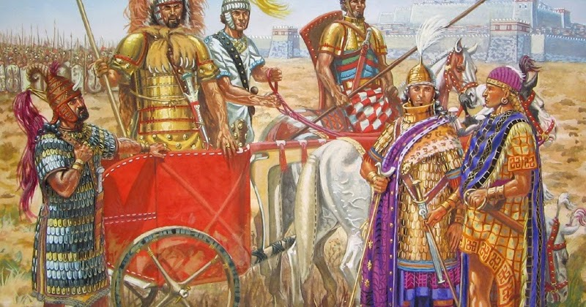
PREDICT
Analyse the images below.
STEP 1: THINK – what do you THINK the Minoan social structure was like?
- this should be conducted alone, silently, for ONE (1) minute -

Slide 4
PREDICT
STEP 2: PAIR – Pair up with a partner. Discuss what you THINK the Minoan social structure was like, based on the images you saw.
- what evidence was there?-

Slide 5
PREDICT
Discussion of analysis
STEP 3: CLASS DISCUSSION OF RESPONSES

Slide 6
Today’s Lesson
Social structure of minoan society

Slide 7
Social Structure
KEY TERM
DEFINITION:
the social organization of a society constituting an integrated whole
What social hierarchies do you already know of?

Slide 8
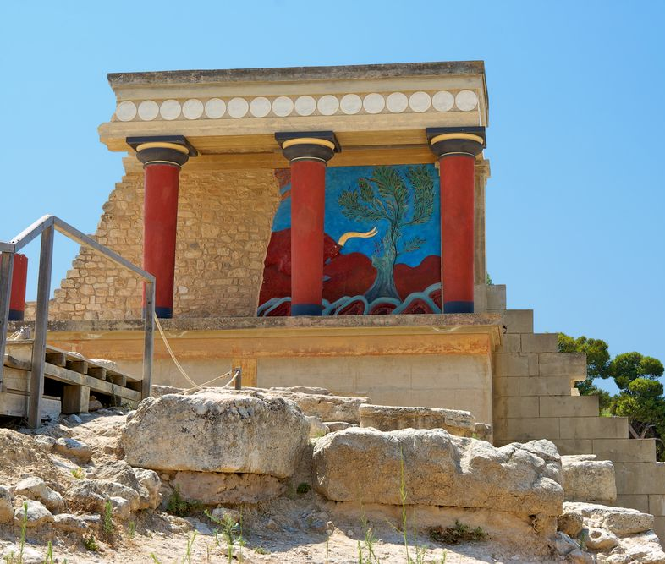
Palaces
Size of building relevant to status
Knossos palace was the political, social and cultural centre of the Minoan culture during the Early and Middle Bronze Age.
It was the largest palace site.
Absence of fortifications in the settlements suggests a relatively peaceful co-existence between the different communities.
Presence of weapons such as swords, daggers, and arrowheads, and defensive equipment such as armour and helmets would also suggest that peace may not always have been enjoyed.
Minoan roads, too, have evidence of regular guardhouses and watchtowers.

Slide 9
ACTIVITY – Minoan Social Hierarchy
Draw the following in your book

Slide 10
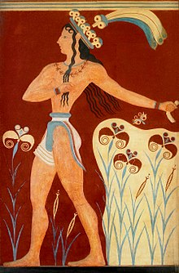
1. Minos
Title like ‘pharaoh
‘Priest/king’
Prince of the Lilies Fresco from Palace of Knossos

Slide 11
2. Wanax (Wa-Na-Ka)
King - made laws and determined the rate of taxes
defined the international conditions
had vast areas of land
Power from hereditary succession (family lines)
All references made to the king are in the context of festivals or places of ceremony

Slide 12
3. Lawagetas
The one that leads the people/army
Leader of the army
Duties: imposing the order to the state and leading the army in military operations
largest landholder after the wanax
Various craftsmen were employed under his service

Slide 13
4. Hequetai
Translated as “The Followers”
A group of high level nobles who surrounded the Wanax, and operated as an inner circle and a security entourage
Formalized version of the King's closest maryannu (chariot riding slaver aristocrats)
Special clothing which may have been reserved for their maryannu class.
Special status in Aegean society, as well as the connection between wealth and family in Minoan societies.

Slide 14
5. Palace Elite
Priests and priestesses who would be responsible for leading and performing religious rituals and services
Perhaps because it was a goddess religion or because the society had important roles for women, there were many more priestesses than priests

Slide 15
6. Skilled Workers/Craftsmen
Blacksmiths, jewellers, metal workers, chariot makers, potters, shepherds, beekeepers, farmers

Slide 16
7. Slaves
It is likely that slaves existed - Common in the Bronze Age
Owned by elite? Traded?

Slide 17

While the royalty of the civilisation were kings not queens and men ran many parts of the society, the Minoan civilisation seems to have allowed women to do the same things men did. This civilisation probably did not have a land army, but a navy, so when the men in the navy were off at sea, women probably helped run much of Minoan society and politics. Women and men even participated in the same sports. Some of the most popular sports that both genders participated in were wrestling and bull-jumping, a sport where a bull ran at a person who would then try to jump and somersault over it. Also, unlike the later religion of Greece, which emphasised the male gods like Zeus, Minoan religion was primarily composed of worshiping goddesses.

Slide 18
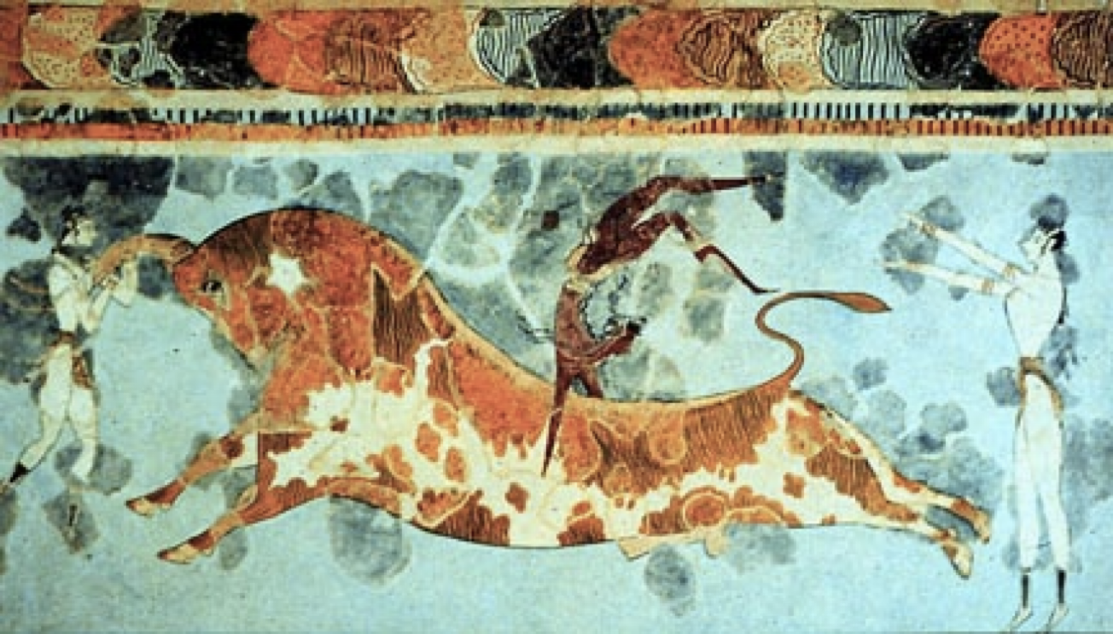
Notes:
In Minoan art/artefacts, men and women are depicted differently: Male skin is usually red, female is white

Slide 19
ACTIVITY – Practice Source Analysis
Choose ONE (1) of the sources to analyse and complete the questions.
Swap with ONE (1) other student for feedback.
SUMMARY
Describe the Minoan social structure in 10 words.

